Slide 1
Data Structures and Algorithms (BCSE202L) Module 1: Algorithm Analysis
Dr. Priyanka N

Slide 2
Asymptotic Notations
Asymptotic notations are the mathematical notations used to describe the running time of an algorithm when the input tends towards a particular value or a limiting value
There are mainly three asymptotic notations:
Big-O notation (Ο Notation)
Omega notation (Ω Notation)
Theta notation (θ Notation)

Slide 3
Big-O Notation (O-notation)
Big-O notation represents the upper bound of the running time of an algorithm
It gives the worst-case complexity or the longest amount of time an algorithm can possibly take to complete
Mathematical Representation of Big-O Notation:
The above expression can be described as a function f(n) belonging to the set O(g(n)) if there exists a positive constant c such that it lies between 0 and c.g(n), for sufficiently large n
O(g(n)) = { f(n): there exist positive constants c and n₀ such that 0 ≤ f(n) ≤ c.g(n) for all n ≥ n₀ }

Slide 4
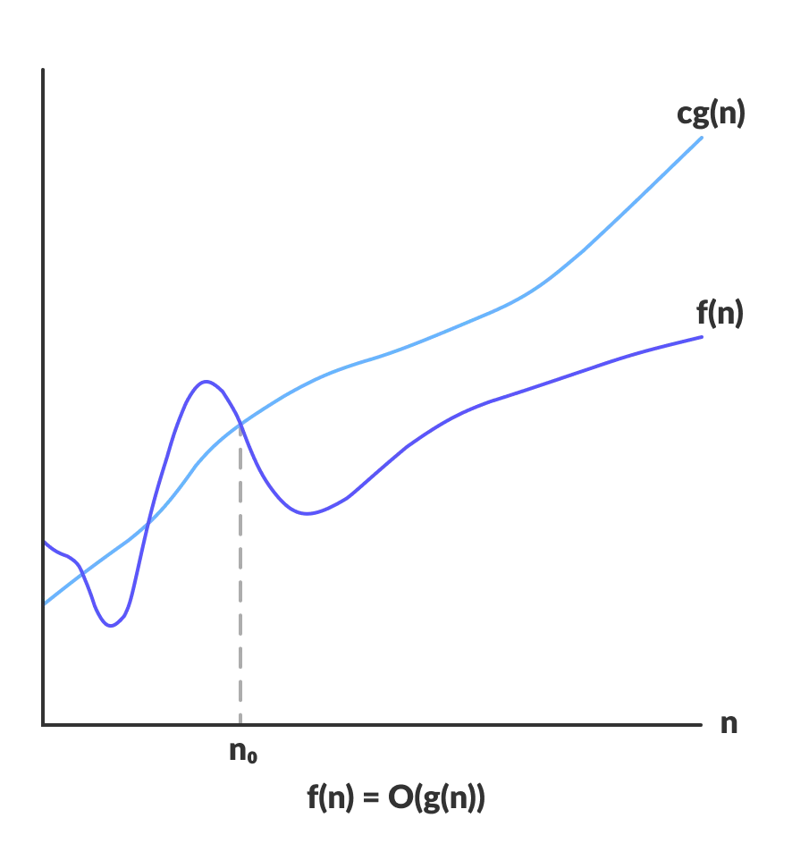
Big-O Notation (O-notation)

Slide 5
Omega notation (Ω Notation)
Omega notation represents the lower bound of the running time of an algorithm
It provides the best-case complexity of an algorithm
Mathematical Representation of Omega Notation:
The above expression can be described as a function f(n) belonging to the set Ω(g(n)) if there exists a positive constant c such that it lies above c.g(n), for sufficiently large n
For any value of n, the minimum time required by the algorithm is given by Omega Ω(g(n))
Ω(g(n)) = { f(n): there exist positive constants c and n₀
such that 0 ≤ cg(n) ≤ f(n) for all n ≥ n₀ }

Slide 6
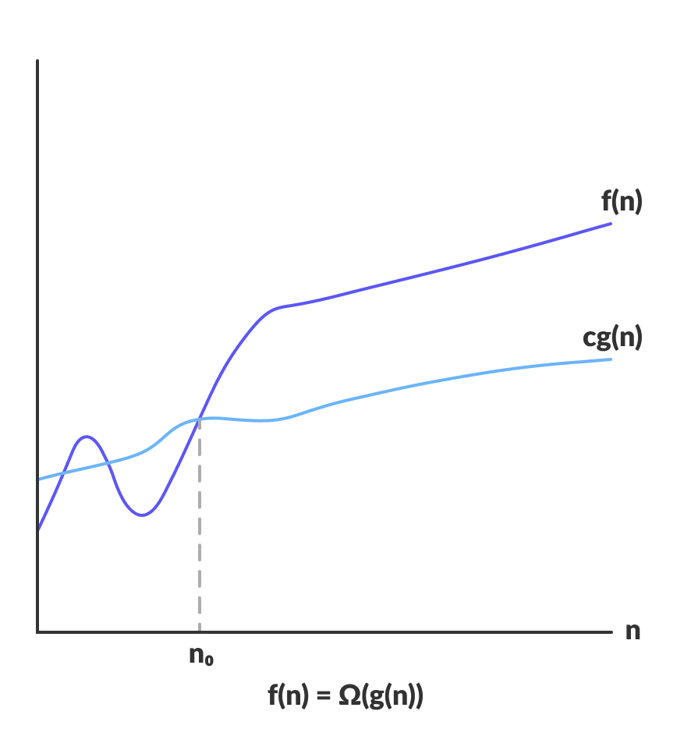
Omega notation (Ω Notation)

Slide 7
Theta Notation (Θ-notation)
Theta notation encloses the function from above and below
Since it represents the upper and the lower bound of the running time of an algorithm, it is used for analyzing the average-case complexity of an algorithm
Mathematical Representation of Omega Notation:
The above expression can be described as a function f(n) belongs to the set Θ(g(n)) if there exist positive constants c1 and c2 such that it can be sandwiched between c1.g(n) and c2.g(n), for sufficiently large n
If a function f(n) lies anywhere in between c1.g(n) and c2.g(n) for all n ≥ n₀, then f(n) is said to be asymptotically tight bound
Θ(g(n)) = { f(n): there exist positive constants c1, c2 and n₀ such that 0 ≤ c1.g(n) ≤ f(n) ≤ c2.g(n) for all n ≥ n₀ }

Slide 8
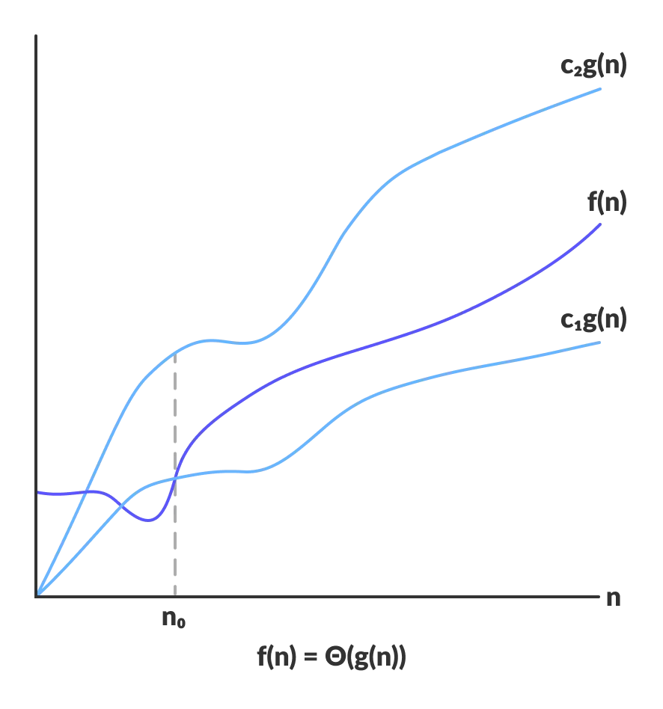
Theta Notation (Θ-notation)

Slide 9
Worst-case, Average-case, Best-case, and Amortized Time Complexity
Generally, we perform the following types of analysis:
Worst-case − The maximum number of steps taken on any instance of size a
Best-case − The minimum number of steps taken on any instance of size a
Average case − An average number of steps taken on any instance of size a

Slide 10
Worst-case Time Complexity
This denotes the behavior of an algorithm with respect to the worst possible case of the input instance
The worst-case running time of an algorithm is an upper bound on the running time for any input
Having the knowledge of worst-case running time gives us an assurance that the algorithm will never go beyond this time limit

Slide 11
Average-case Time Complexity
The average-case running time of an algorithm is an estimate of the running time for an ‘average’ input
It specifies the expected behavior of the algorithm when the input is randomly drawn from a given distribution
Average-case running time assumes that all inputs of a given size are equally likely

Slide 12
Best-case Time Complexity
The term ‘best-case performance’ is used to analyze an algorithm under optimal conditions
For example, the best case for a simple linear search on an array occurs when the desired element is the first in the list
However, while developing and choosing an algorithm to solve a problem, we hardly base our decision on the best-case performance
It is always recommended to improve the average performance and the worst-case performance of an algorithm

Slide 13
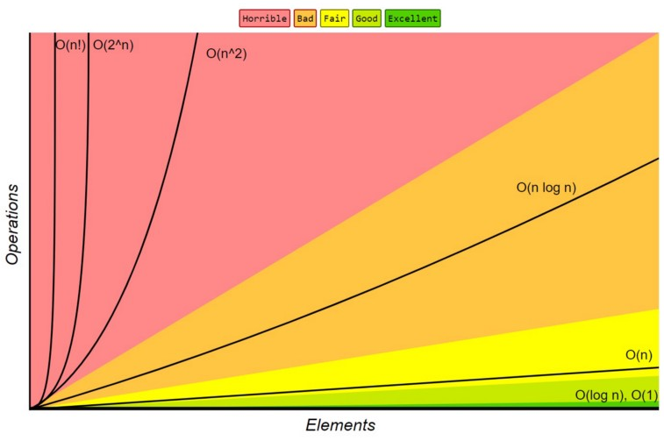
Order of Growth
Order of Growth:
1<logn<√n<n<nlogn<n²<n³<……2^{n} < 3^{n}<n^{n}

